Slide 1
Data Management CT051-3-M
Topic 1 - Introduction and Overview

Slide 2
Lecturer Information
Lecturer– Dr. Murugananthan Velayutham
Email - murugananthan@staffemail@apu.edu.my

Slide 3
Topic & Structure of Lesson
In this lecture we will look at:
Module overview
Assessment requirements
Teaching strategies

Slide 4
Learning Outcomes
By the end of this lesson you should
be able to:
Recognise the requirements of the module

Slide 5
Pre-requisites for this module
Nil

Slide 6
Topics we will cover
Organizational Data Preparation (Databases, Data Marts, Data Warehouse)
Data Type & Behavior (Quantitative Data, Qualitative Data)
Data Preprocessing (Data Cleaning, Data Integration & Transformation, Data Reduction)
Exploratory Data Analytics (Exploring structured)
Data Warehouse and Hadoop (Data Warehouse- Architecture & Implementation & Multidimensional Data Models)
Unstructured Data Into Hadoop (USE CASE)
Query Data using Hadoop (HiveQL – DDL, DML)
Data Security and Governance (Security policies & Procedures)
Notes:
80% of time, organization spend in preparing the data for analysis. And this process in called with different terms by business analyst or data analyst such as data management, data munging, data structuring, data blending, shaping and wrangling.
Source: Database, Data Marts and DW
Common data classification – qualitative and quantitative

Slide 7
What support is available for you
Capriolo, E., Wampler, D. and Rutherglen, J., (2012). Programming Hive: Data warehouse and query language for Hadoop. O'Reilly Media, Inc.
Jiawei Han, Micheline Kamber, Jian Pei (2011). Data Mining: Concepts and Techniques, (The Morgan Kaufmann Series in Data Management Systems). 3rd ed. San Francisco: Morgan Kaufmann
Gerhard Svolba (2006). Data Preparation for Analytics Using SAS®. SAS Institute

Slide 8
What support is available for you
Reference material:
Websites
Conference papers
Journals
e-books

Slide 9
How you will be assessed
Individual Assignment – 80%
Assignment Pt 1 : 20% - FE – creating/transformation
Pt 2 : 60% (do this first)
Data cleaning – data preprocessing
Handling outliers
Visualization
Test : 20%

Slide 10
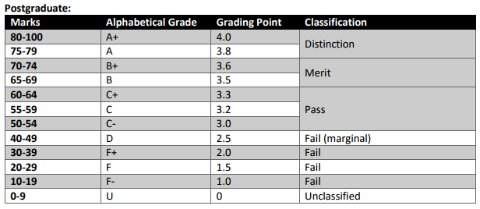
Achievement requirements

Slide 11
Question & Answer Session
Q & A

